Slide 1
Low-Cost Real-Time Water Depth Measurement System Using a Camera
Bienvenido Hiyas Jr.
Master of Engineering – IoT and Data Engineering
James Cook University
Supervisor: Tao Huang (Kevin)

Slide 2
Background

Slide 3
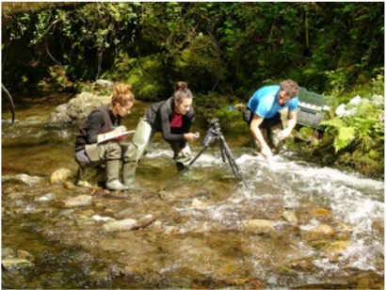
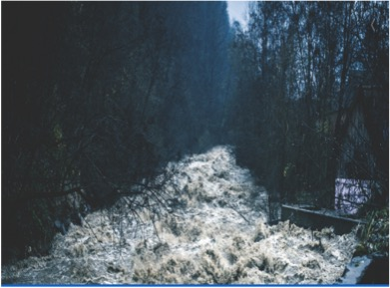
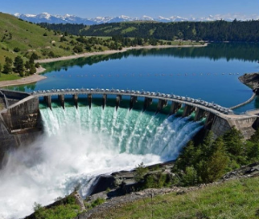
Water Depth / Water Level
Environmental Monitoring, Research and Restoration
Prevents Flood
Water Reserve Monitoring
https://www.optex.co.jp/e/solutions/river-monitoring.html
https://interestingengineering.com/13-of-the-worlds-most-fascinating-dams

Slide 4
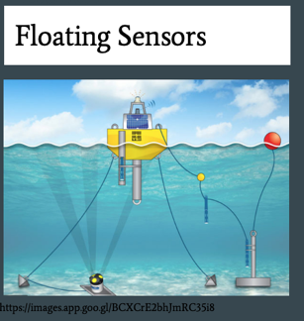
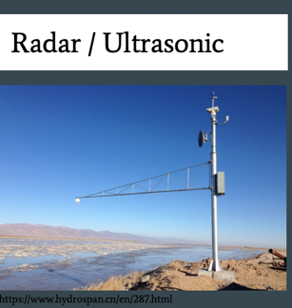
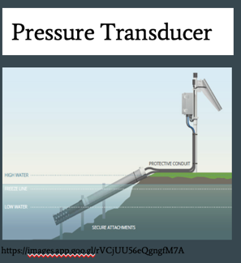
Water Depth Measurement System Using a Camera
Advantages over Conventional Method
Less Cost
More Convenient Installation
Visual Monitoring

Slide 5
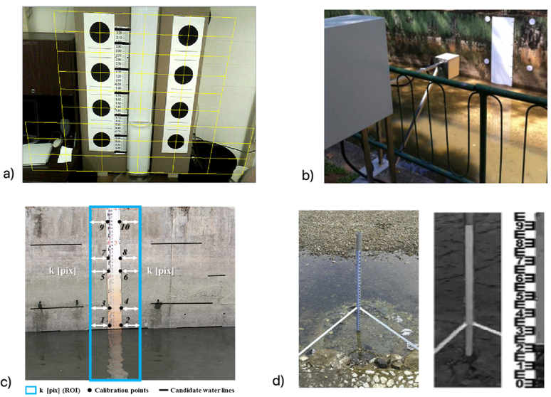
Previous Works
Calibration Fiducials
Large Black Dots
White Circles
Reference Points
Orthographic Template

Slide 6
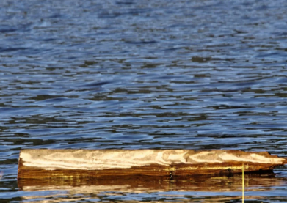
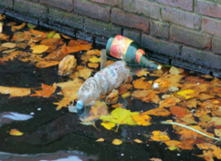
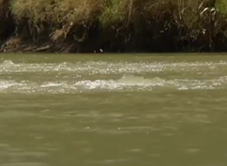
Challenges
Unavoidable Conditions in the water
Floating Logs, Branches etc.
Debris (trashes)
Bubbles
https://morgridge.org/blue-sky/why-do-some-logs-float-and-some-sink/
https://www.clarionmunicipal.com/floating-debris.html
https://www.abc.net.au/news/2016-02-14/condamine-river-mysterious-bubbling-intensifying-landholders-say/7139676

Slide 7
Project Question
How to develop a low-cost real-time water depth measurement system using a camera with easy and convenient calibration process and can distinguish water lines from water debris or obstacles?

Slide 8
Project:
Image processing algorithm that measures water level in an image of a camera
Rectangular Marker as the Calibration Fiducial
Trapezoidal V-Shape ROI
Benefits:
Visual Monitoring on the Surroundings
Less sophisticated installation and easy calibration
Can distinguish waterline in the water channel

Slide 9
Methodology

Slide 10
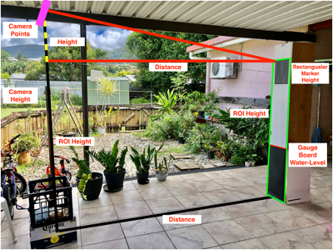
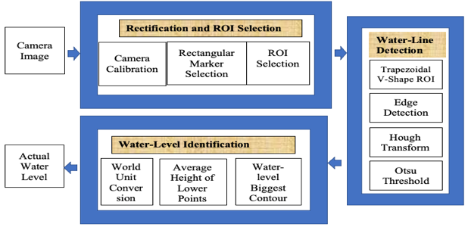
System Architecture and Water-level Detection Algorithm
Mobile Phone Camera
Rectangular Marker
Region Of Interest (ROI)
Algorithm
Rectification and ROI Selection
Waterline Detection
Water-level Identification

Slide 11
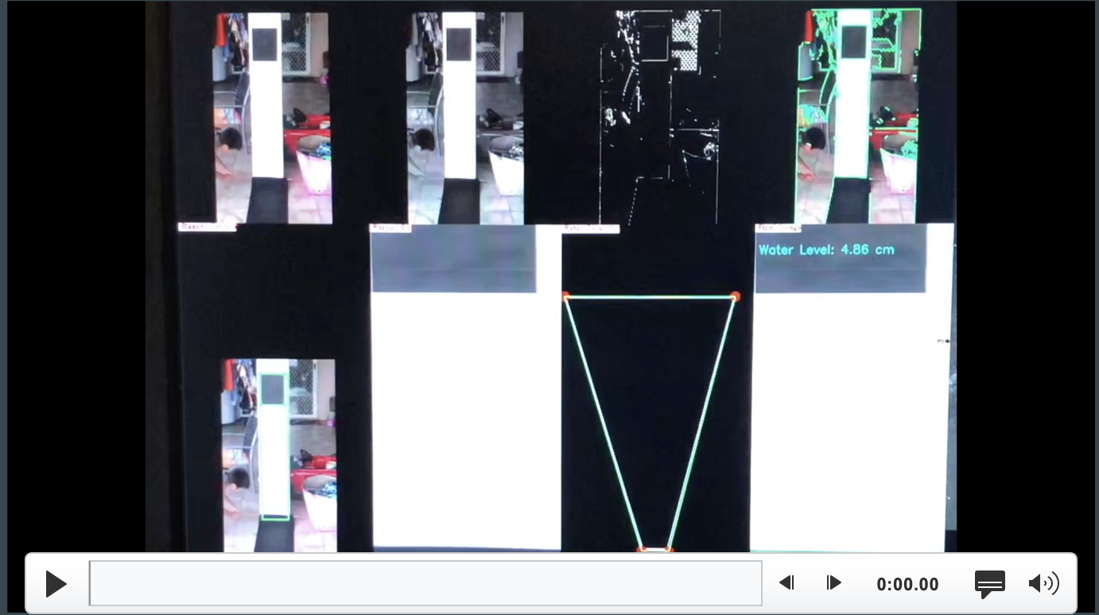
Simulation Video
video link: https://youtu.be/jnQBZyS0rdU

Slide 12
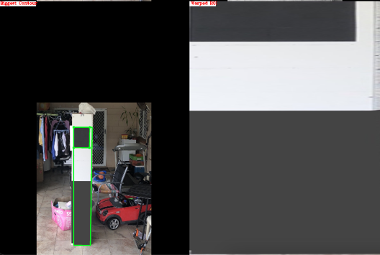
Rectification and ROI Selection
Camera Calibration
Rectangular Marker Detection
ROI Points Selection
Perspective and Warp Transformation
ROI Image
Notes:
lenAB = sqrt(pow(A.x - B.x, 2.0) + pow(A.y - B.y, 2.0));
C.x = B.x + (B.x - A.x) / lenAB * (length – lenAB);
C.y = B.y + (B.y - A.y) / lenAB * (length-lenAB;

Slide 13
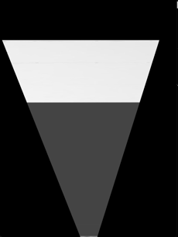
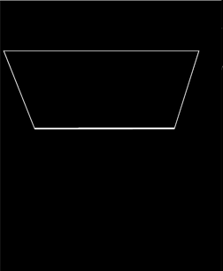
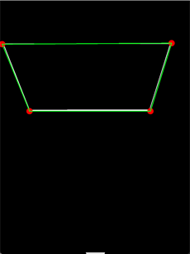
Waterline Detection
Trapezoidal V-shaped ROI
Canny Edge /Hough Line /Otsu Threshold
Biggest Contour
Water-level Identification
Average Height of Lower Points of the biggest contour (trapezoid)
ROI Height
Actual Water Level
Notes:
THe color difference formula used is CIELABS. International Commission on Illumination CIE lab
It expresses color as three values: L* for the lightness from black (0) to white (100), a* from green (−) to red (+), and b* from blue (−) to yellow (+)
Color differences were measured in the CIELAB space as the Euclidean distance between the coordinates of the two stimuli.

Slide 14
Results and Discussions

Slide 15
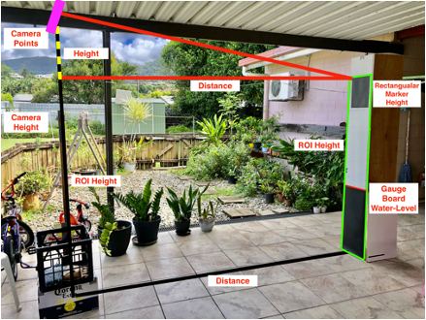
The Experiment
Controlled Environment
Various Variables
Gauge Board Water-Level

Slide 16
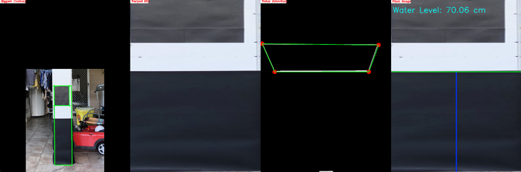
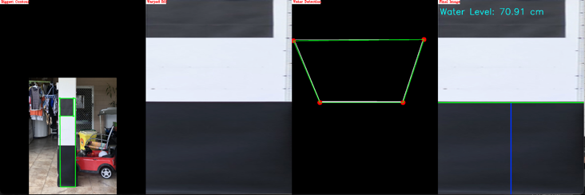
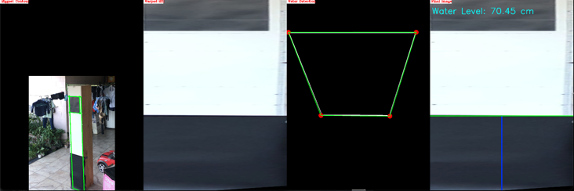
The Experiment
Average Accuracy of 98.71 %
Min = 97.2 %, Max = 99.96 %
50

Slide 17
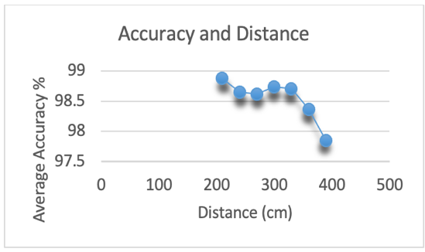
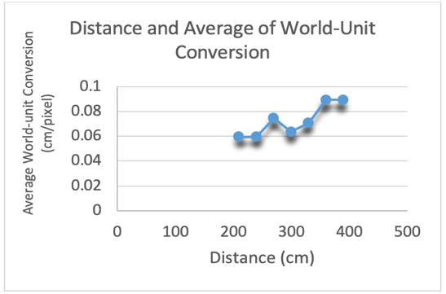
Distance, World-Unit Conversion, and Accuracy

Slide 18
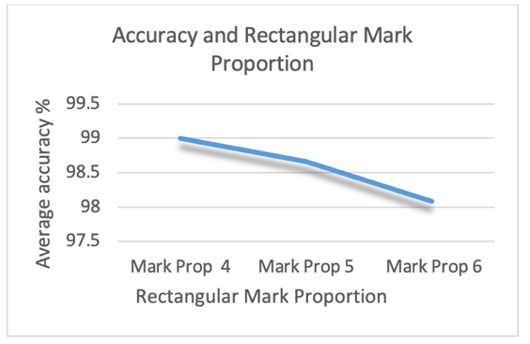
Rectangular Mark Proportion and Accuracy
Notes:
To convert the position of the line from the water-level measurement system to world units(feet/meters)
As you can see in the pictures, All of them are in contact with the water and basically it should be low tide before they can be installed.
As discussed earlier here are some methods that is used for calibration and convert the image pixel units into world units (feet/meters). However, most of these methods needs to be in contact with the water and basically need to wait for a low tide before they can install them.

Slide 19
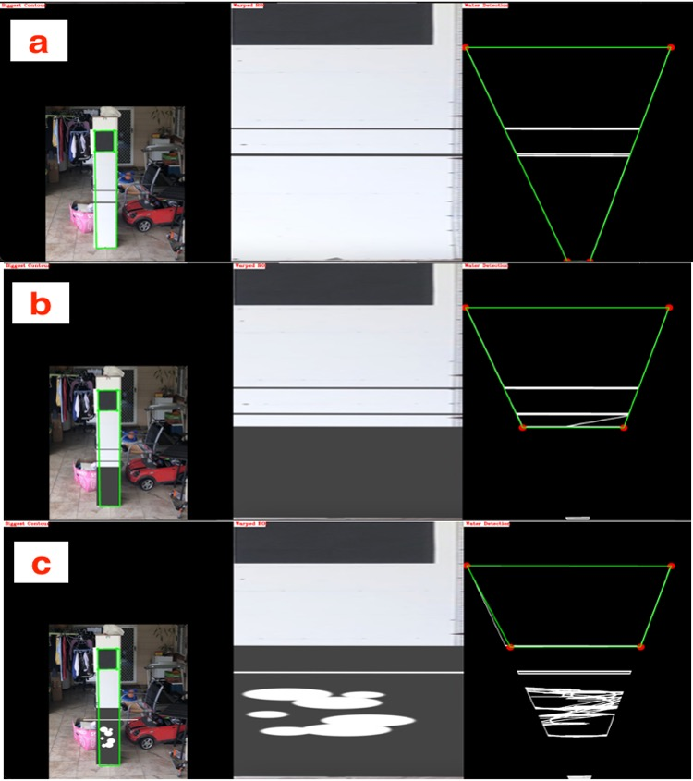
Simulations Using the Trapezoidal V-Shaped ROI
Lines are considered as Floating Objects, etc.
Circles are considered as bubbles and other debris.
Gray rectangle is considered as the water-level.

Slide 20
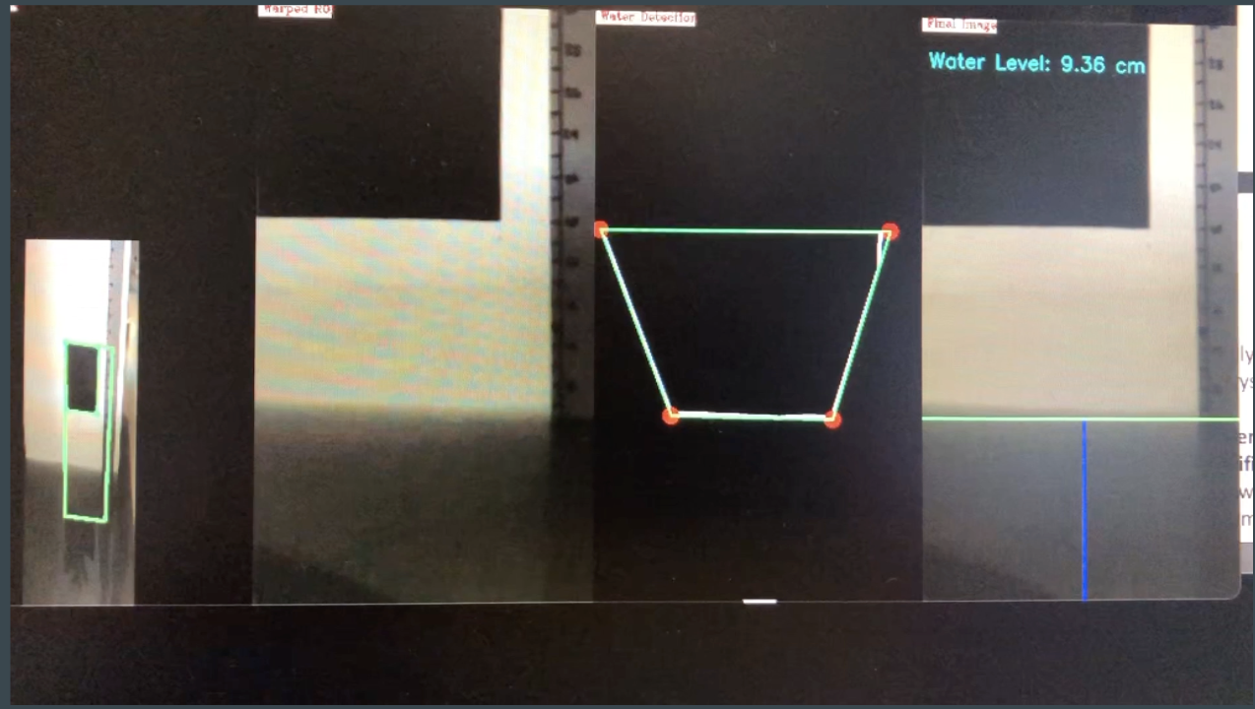
Video on Actual Water Level Detection Experiment in a Sink
Video link: https://youtu.be/1bJy7GafNSc

Slide 21
Summary

Slide 22
Summary
Rectangular Marker
Algorithm has successfully identified ROI points for ROI mapping and calibration, and have easier installation.
Trapezoidal V-Shaped ROI
Successfully distinguished waterline from floating debris in the simulation.
Overall Accuracy
More than 98%, with specific camera resolution and specific distance from gauge board
Accuracy
Accuracy depends on the camera resolution.

Slide 23
Future works
The proposed Algorithm should be experimented in actual water channel and with water level.
The Roi Selection method using the rectangular marker together with an automatic distance and image height detection could be promising for automatic and adaptive ROI selection at any position of the camera.
Image segmentation can be used together with trapezoidal V-Shaped ROI method where there is no need for white background or gauge board.
Longest Line detection could also be used along with trapezoidal V-Shaped ROI method to improved waterline detection.

Slide 24
Thank you! Questions?

